Slide 1
Key Features:
Pixel-Perfect Precision: Offers meticulous control over report layouts, ensuring elements like tables, charts, and images are precisely positioned for consistent presentation across various formats.
Diverse Data Source Integration: Supports connections to multiple data sources, including SQL Server, Oracle, Excel, and Power BI datasets, enabling comprehensive data consolidation.
Advanced Data Visualizations: Provides tools to incorporate charts, maps, sparklines, and data bars, enhancing the interpretability of complex data.
Dynamic Parameters: Allows the inclusion of parameters for filtering data, enabling users to customize report outputs based on specific criteria.
Flexible Export Options: Facilitates exporting reports to various formats such as PDF, Word, Excel, and MHTML, catering to diverse distribution and presentation needs.
Benefits:
Consistent and Standardized Reporting: Ensures uniformity in report formats, aiding compliance with regulatory standards and corporate branding guidelines.
Enhanced Data Presentation: Transforms raw data into structured, easily digestible reports, enabling stakeholders to derive actionable insights efficiently.
Scheduled Report Delivery: Supports automated report generation and distribution, ensuring timely dissemination of information without manual intervention.
Seamless Integration with Power BI Ecosystem: Works in harmony with other Power BI tools, allowing users to leverage existing datasets and models for comprehensive reporting solutions.

Slide 2
Creating a Template in Report Builder

Slide 3
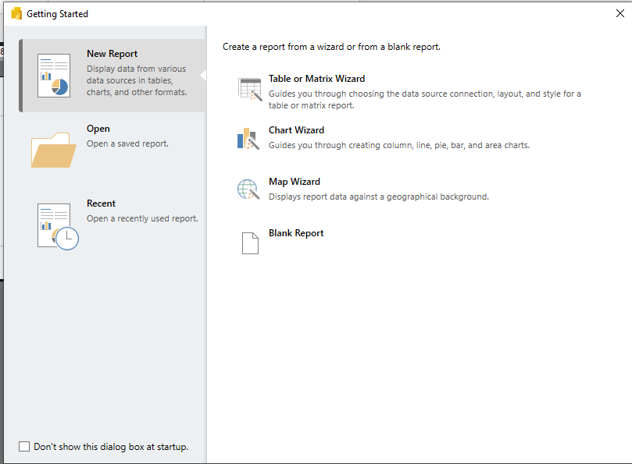
Launch Report Builder

Slide 4
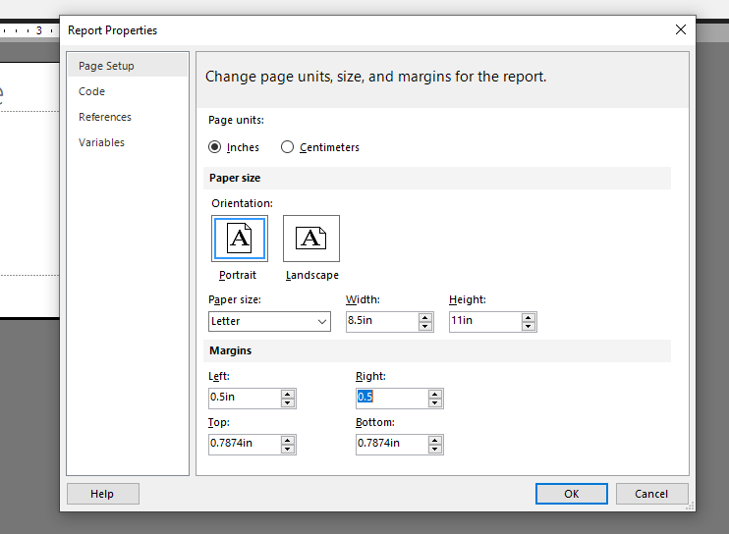
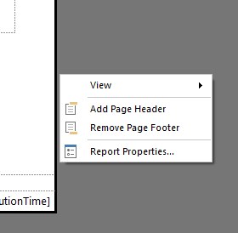
Right Click on Shaded area to get report properties

Slide 5
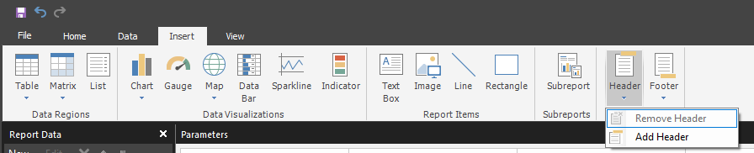

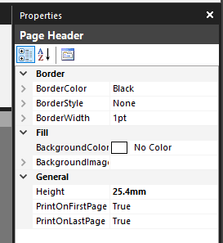
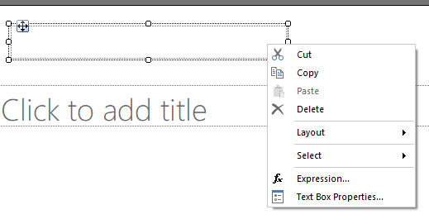


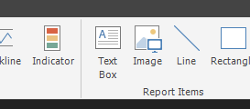

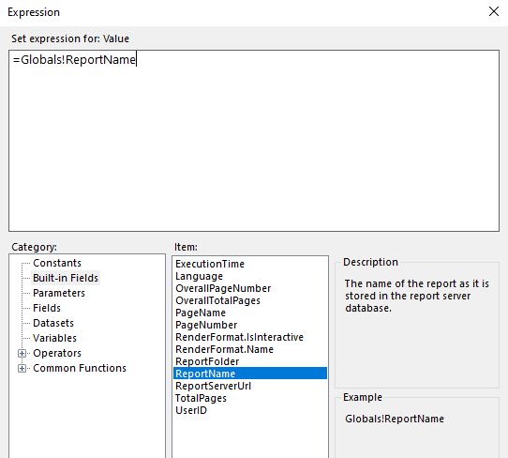

Right Click on Text Label

